Slide 1
Mark’s Mountains

Slide 2
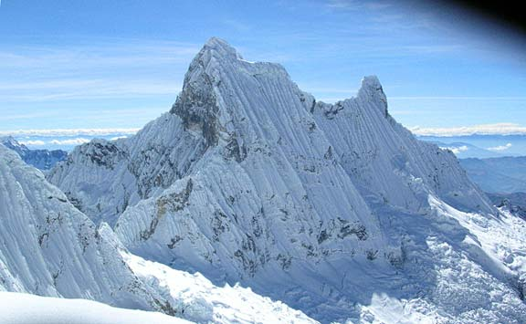
Mount Pisco, youngest to summit, 19,029 feet and was 14, 8/94

Slide 3
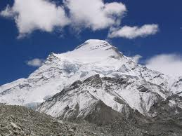
Mount Cho Oyu, 26,750 feet, youngest to summit, 16, 9/96
In fact, even know Mark attempted to climb the highest mountain in the world; the elevation he reached still did not reach the amount he climbed on Cho Oyu which was 26,750. The highest on record Mark Pfetzer climbed. It is stated that the Cho Oyu was in fact Cho Oyu was easiest 8000 meter climb reported by experienced mountain climbers who have done this Endeavour.

Slide 4
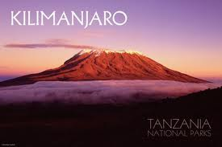
Mount Kilimanjaro, Africa, 19,340 feet, summited, 16, 7/96

Slide 5
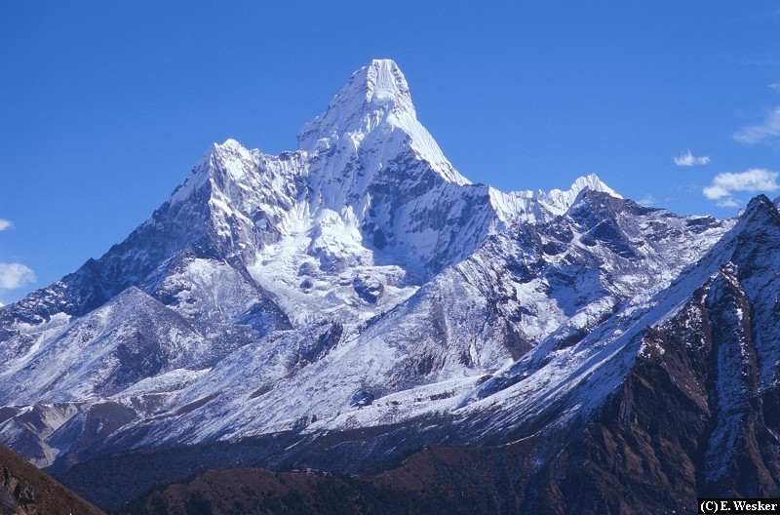
Ama Dablam, Nepal, 22,350 feet, youngest to summit, 15, 10/95

Slide 6
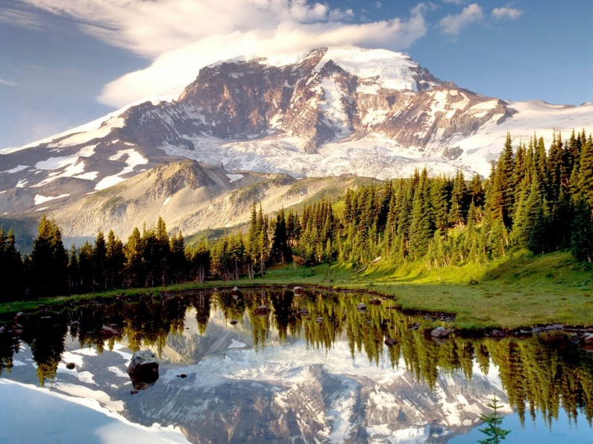
Mount Rainer, Washington, 15,410 feet, summited, 15, 8/95

Slide 7
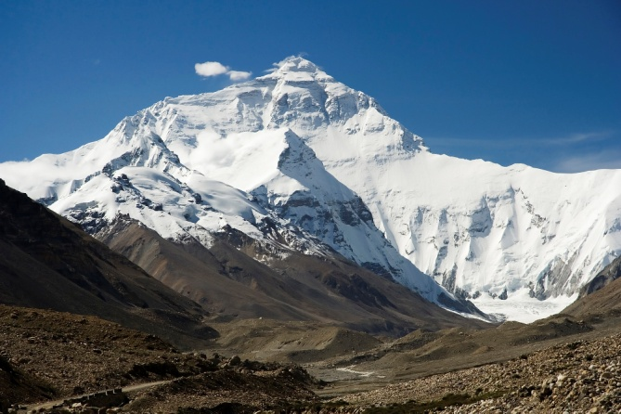
Mount Everest Tibet side, 25,000 feet, youngest on climb, 15, 5/95

Slide 8
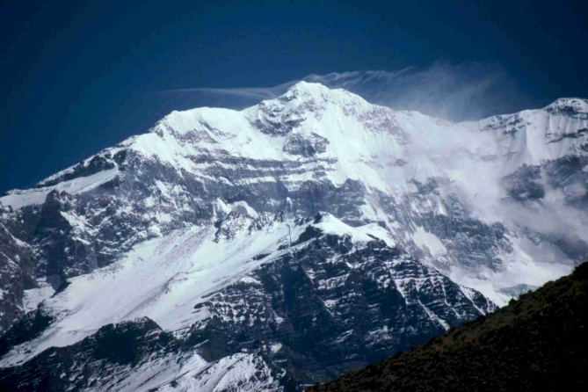
Aconcagua, Argentina, 22,834 feet, Summited, 15, 2/95

Slide 9
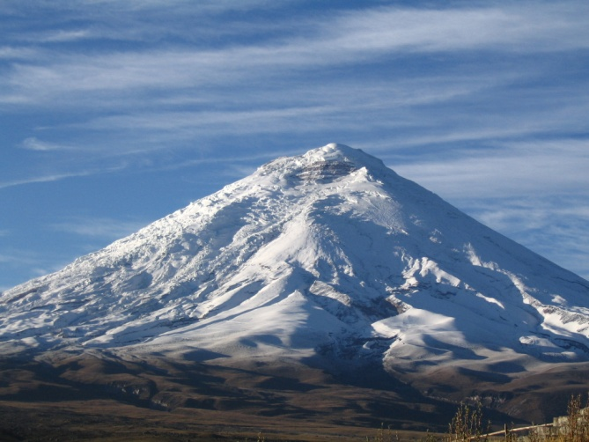
Cotopaxi, Ecuador, 19,347 feet, youngest to summit, 12/94, 14

Slide 10
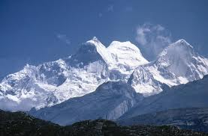
Huascaran, Peru, 22,205 feet, youngest to summit, 8/94, 14

